Slide 1
San Ramon Valley
Unified School District
Remote Learning and Reopening Update
September 29, 2020

Slide 2
Agenda
Introduction and Context
Feedback and Remote Learning Update
Stakeholder Feedback on Reopening
SRVUSD Plan for Reopening
Notes:
John

Slide 3
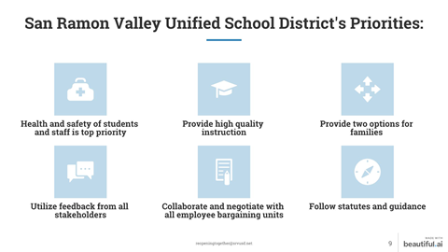

Slide 4
Introduction and Context
Complex layers
Requirements as we move to Red Tier
Why hybrid? Next steps
Choice and potential interruptions
Waiver process
Our challenge
Notes:
John

Slide 5
Utilize Feedback from all Stakeholders
Use of Thought Exchange suggestions and ratings
Analysis of survey data
Negotiation and consultation with stakeholder groups
Professional perspectives from District staff informed by collaboration
Notes:
Bring to John’s slide

Slide 6
Resuming In-Person Instruction:
Work to Date
Remote Learning
Special Education
Survey Results
Collaborative Working Group Results
Operational/Safety
Planning Guide

Slide 7
Remote Learning Update: Overview
Thought Exchange Themes
Collaboration with union groups
Schedules
Notes:
Christine

Slide 8
Remote Revised Bell Schedules:
Elementary School
Lunch aligns with Middle and High School schedules
Longer lunch for elementary students
Start time - 5 minutes later, which supports aligned lunches
All Remote Learning schedule changes take effect on Monday October 12
Notes:
Nadine

Slide 9
PreSchool, Transitional Kindergarten, Kindergarten
Full Remote Bell Schedules
Monday Common Learning Schedule
Time | Minutes | Period Schedule
8:00-11:00 | 180 | Learning**
11:00-11:30 | 30 | Lunch
11:30-12:00 | 30 | Assignment Completion
Regular Schedule Tuesday-Friday
Time | Minutes | Tuesday | Wednesday | Thursday | Friday
8:00 - 11:00 | 180 | Learning** | Learning** | Learning** | Learning**
11:00 - 11:30 | 30 | Lunch
11:30 - 12:00 | 30 | Student Support*
12:00 - 12:30 | 30 | Assignment Completion | Assignment Completion | Assignment Completion | Assignment Completion
*Additional Dates for Common Learning Schedule
August 14, 18, 19, 20, 21
Minimum Day Schedule
Time | Minutes | Period Schedule
8:00-10:30 | 150 | Learning**
10:30-11:00 | 30 | Assignment Completion
11:00-11:30 | 30 | Lunch
For students who have both CEIA/SDC preschool programs, their programs will be split between the 8:00-11:00 am time frame (90 minutes each).
*Student Support may consist of teacher access, parent conferences, tutorials, and small group learning. No whole group instruction will occur during this time.
**Learning: Each block may include a combination of direct instruction, collaborative work, small-group support, and independent learning. Independent learning is defined as the time students spend outside the remote learning classroom completing assigned activities.
Additional Dates for Minimum Day Schedule
August 13
September 15
October 5, 6, 7, 8, 9
January 26
March 10, 11, 12, 23
June 3
Notes:
Nadine

Slide 10
Grades 1-5 Elementary Full Remote Bell Schedules
Monday Common Learning Schedule
Time | Minutes | Period Schedule
8:05 - 8:15 | 10 | Morning Meeting
8:15 - 9:05 | 50 | Learning **
9:05 - 9:55 | 50 | Learning **
9:55 - 10:10 | 15 | Break
10:10 - 11:00 | 50 | Learning **
11:00 - 11:30 | 30 | Lunch
11:30 - 12:30 | 60 | Student Support*
12:30 - 2:25 | Teacher Professional Development & Collaboration
Regular Schedule Tuesday-Friday
Time | Minutes | Tuesday | Wednesday | Thursday | Friday
8:05 - 8:15 | 10 | Morning Meeting | Morning Meeting | Morning Meeting | Morning Meeting
8:15 - 9:05 | 50 | Learning** | Learning** | Learning** | Learning**
9:05 - 9:55 | 50 | Learning** | Learning** | Learning** | Learning**
9:55 - 10:10 | 15 | Break
10:10 - 11:00 | 50 | Learning** | Learning** | Learning** | Learning**
11:00 - 11:40 | 40 | Lunch
11:40 - 12:30 | 50 | Learning** | Learning** | Learning** | Learning**
12:30 - 1:20 | 50 | Learning** | Learning** | Learning** | Learning**
1:20 - 2:10 | 50 | Learning** | Learning** | Learning** | Learning**
2:10 - 2:25 | 15 | Student Support* | Student Support* | Student Support* | Student Support*
Additional Dates for Common Learning Schedule
August 13, 14, 18, 19, 20, 21
September 15
October 6, 7, 8, 9
January 26
March 10, 11, 12, 23
June 3
*Student Support may consist of teacher access, parent conferences, tutorials, office hours, and small group learning. No whole group instruction will occur during this time.
**Learning: Each block may include a combination of direct instruction, collaborative work, small-group support, and independent learning. Independent learning is defined as the time students spend outside the remote learning classroom completing assigned activities.
Notes:
Nadine

Slide 11
Remote Revised Bell Schedules: Middle School
Lunch aligned with Elementary and High Schools
Lunch is earlier in the day
Start time - 8:20 a.m., which supports aligned lunches
All Remote Learning schedule changes take effect on Monday October 12
Notes:
Jon

Slide 12
Middle School Full Remote Bell Schedules
Monday Common Learning Schedule*
Time | Minutes | Period Schedule
8:20 - 8:55 | 35 | Period 1
8:55 - 9:00 | 5 | Passing
9:00 - 9:35 | 35 | Period 2
9:35 - 9:40 | 5 | Passing
9:40 - 10:15 | 35 | Period 3
10:15 - 10:25 | 10 | Brunch/Passing
10:25 - 11:00 | 35 | Period 4
11:00 - 11:05 | 5 | Passing
11:05 - 11:40 | 35 | Period 5
11:40 - 12:10 | 30 | Lunch
12:10 - 12:15 | 5 | Passing
12:15 - 12:50 | 35 | Period 6
12:50 - 12:55 | 5 | Passing
12:55 - 1:30 | 35 | Period 7
1:30 - 2:50 | Teacher Professional Development & Grade Level Collaboration
Regular Schedule Tuesday-Friday*
Time | Minutes | Tuesday | Wednesday | Thursday | Friday
8:20 - 9:35 | 75 | Period 1 | Teacher Collaboration | Period 1 | As-Needed Student Support***
9:35 - 9:45 | 10 | Passing | Passing | Passing | Passing
9:45 - 11:00 | 75 | Period 3 | Period 2 | Period 3 | Period 2
11:00 - 11:40 | 40 | Lunch | Lunch | Lunch | Lunch
11:40 - 12:55 | 75 | Period 5 | Period 4 | Period 5 | Period 4
12:55 - 1:05 | 10 | Passing | Passing | Passing | Passing
1:05 - 2:20 | 75 | Period 7 | Period 6 | Period 7 | Period 6
2:20 - 2:50 | 30 | Student Support** | Student Support** | Student Support** | Student Support**
*Additional Dates for Regular Schedule:
Sept. 14 (odd day) & Sept. 28 (even day)
*
**Student Support: support period for SEL, parent conferences, intervention, tutorial, make up, study hall, etc. attached to 6th/7th period classes. Roll is taken.
***As-Needed Student Support will be arranged by the classroom teacher. It is not a scheduled class and attendance is not mandatory.
Each period is 75 minutes and may include a combination of direct instruction, collaborative work, small-group support, and individual work time with teacher feedback. All students may be assigned independent learning. Independent learning is defined as the time students spend outside the remote learning classroom completing assigned activities.
*Additional Dates for Common Learning Schedule
Aug. 13, 14 | Sept. 15 | Oct. 6, 7, 8, 9 | Jan. 26 March 10, 11, 12, 23 | June 3
Notes:
Jon

Slide 13
Remote Revised Bell Schedules: High School
Class periods reduced by 5 minutes with no reduction in student support
Passing periods extended to 10 minutes
Lunchtimes aligned with Elementary and Middle Schools
Lunchtime is earlier in the day and extended
A period start time - 8:20 a.m. to help align lunchtimes
All Remote Learning schedule changes take effect on Monday October 12
Notes:
Jon

Slide 14
High School Full Remote Bell Schedules
Monday Common Learning Schedule*
Time | Minutes | Period Schedule
8:20 - 8:55 | 35 | Period A
8:55 - 9:00 | 5 | Passing
9:00 - 9:35 | 35 | Period 1
9:35 - 9:40 | 5 | Passing
9:40 - 10:15 | 35 | Period 2
10:15 - 10:25 | 10 | Brunch + Passing
10:25 - 11:00 | 35 | Period 3
11:00 - 11:05 | 5 | Passing
11:05 - 11:40 | 35 | Period 4
11:40 - 12:10 | 30 | Lunch
12:10 - 12:15 | 5 | Passing
12:15 - 12:50 | 35 | Period 5
12:50 - 12:55 | 5 | Passing
12:55 - 1:30 | 35 | Period 6
1:30 - 2:50 | Teacher Professional Development & Grade Level Collaboration
Regular Schedule Tuesday-Friday*
Time | Minutes | Tuesday | Wednesday | Thursday | Friday
8:20 - 9:00 | 40 | Period A | Period A | Period A | Period A
9:00 - 9:10 | 10 | Passing | Passing | Passing | Passing
9:10 - 10:30 | 80 | Period 1 | Period 2 | Period 1 | Period 2
10:30 - 11:05 | 35 | Student Support** | Student Support** | Student Support** | Student Support**
11:05 - 11:45 | 40 | Lunch | Lunch | Lunch | Lunch
11:45 - 11:55 | 10 | Passing | Passing | Passing | Passing
11:55 - 1:15 | 80 | Period 3 | Period 4 | Period 3 | Period 4
1:15 - 1:25 | 10 | Passing | Passing | Passing | Passing
1:25 - 2:45 | 80 | Period 5 | Period 6 | Period 5 | Period 6
*Additional Dates for Regular Schedule:
Sept. 14 (odd day) & Sept. 28 (even day)
**Student Support: support period for SEL, intervention, tutorial, make up, study hall, etc. attached to 1st/2nd period classes. Roll is taken.
Each period is 80 minutes (with the exception of A period which is 40 minutes) and may include a combination of direct instruction, collaborative work, small-group support, and individual work time with teacher feedback.
All students may be assigned independent learning. Independent learning is defined as the time students spend outside the remote learning classroom completing assigned activities.
*Additional Dates for Common Learning Schedule
Aug. 13, 14 | Sept. 15 | Jan. 26 | March 23 | June 3
Notes:
Jon

Slide 15
Adult Transition: Del Amigo
Full Remote Bell Schedules
Monday Common Learning Schedule*
Time | Minutes | Period Schedule
8:55 - 10:00 | 65 | Learning
10:00 - 10:10 | 10 | Break
10:10 - 11:15 | 65 | Learning
11:15 - 11:25 | 10 | Break
11:25 - 12:30 | 65 | Learning
12:30 - 1:00 | 30 | Teacher Lunch
1:00 - 3:00 | Teacher Professional Development & Grade Level Collaboration
Regular Schedule Tuesday-Friday
Time | Minutes | Tuesday | Wednesday | Thursday | Friday
8:55 - 10:15 | 80 | Learning | Learning | Learning | Learning
10:15 - 10:25 | 15 | Break
10:25 - 11:45 | 80 | Learning | Learning | Learning | Learning
11:45 - 11:55 | 30 | Lunch
11:55 - 1:15 | 80 | Learning | Learning | Learning | Learning
*Additional Dates for Common Learning Schedule
Aug. 13, 14 | Sept. 15 | Jan. 26 | March 23 | June 3
Notes:
“Nothing has changed” pass to Danny

Slide 16
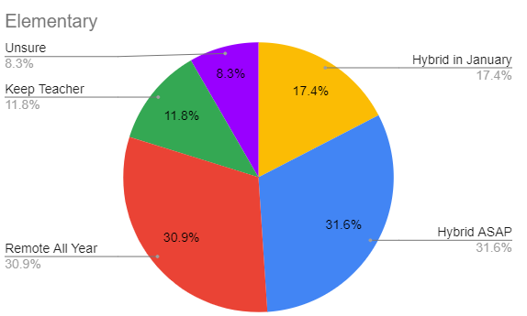
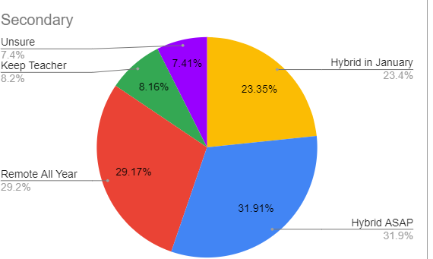
Survey Results: Families
Notes:
Add in total number of people who took the survey, tell the story

Slide 17
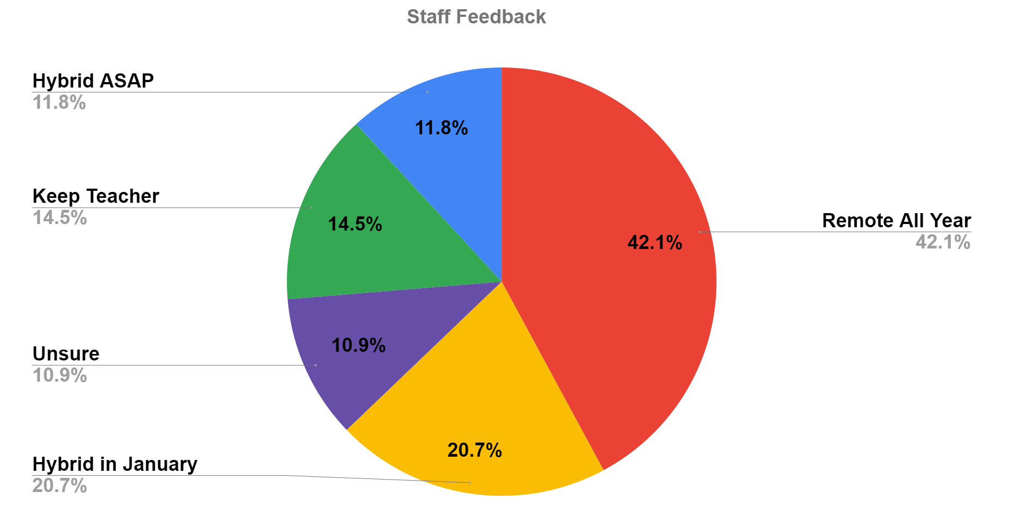
Survey Results: Staff
Notes:
73% response rate of employees, frame properly, wrote staff survey to align to the families, weigh in professionally on what they believe is best for students. Pass to Deb Pettish.

Slide 18
Steering Committees
Collaborative Working Group
Goal: Develop Recommendations for Reopening
Certificated and Classified Staff
Site and District Administrators
Advisory Committees
Parent
Student (Elementary and Secondary)
Staff
Whole Group
Notes:
Deb to introduce the parent reps, explain the process

Slide 19
Collaborative Working Groups: Emerging Themes
Safety should be at the forefront of discussions and inform all ongoing decisions.
Moving to a hybrid environment poses a variety of challenges that still need to be addressed and October does not seem like a realistic timeframe to address these challenges.
Notes:
JOSE SARMIENTO

Slide 20
Collaborative Working Groups: Emerging Themes Continued
The District needs to support the community in understanding what a hybrid learning environment looks like.
Transition to a hybrid model, using a phased-in approach with small groups, can serve as a pilot model for full-scale hybrid instruction.
Notes:
VICTORIA FELIX

Slide 21
Collaborative Working Groups: Emerging Themes Continued
Students TK - 12, should not fully go back to school until second semester, at the earliest.
Schedules in the hybrid model should be AM/PM at the elementary level and block at the secondary level.
Notes:
ANN KATZBURG

Slide 22
Collaborative Working Groups: Emerging Themes Continued
The at-home, asynchronous time should look different depending on the grade level in a hybrid model.
Further evidence needs to be collected and considered before making a final decision about how the transition to hybrid instruction will work for students, from both an academic, as well as an SEL perspective.
Notes:
BRIDGIT Pelley

Slide 23
Special Education
Surveyed our SDC families
Evaluated the best schedule to return students in
Heard directly from over 400 parents and numerous staff in regards to their questions and concerns
Notes:
MaryAnn

Slide 24
Negotiations with Labor Partners
Discussions and negotiations for the reopening of schools to on-campus, in-person learning are underway with all bargaining units (CSEA, SEIU and SRVEA).
Negotiations will expand upon what was negotiated for fully remote instruction and focus on terms and conditions that are specific to on-campus, in-person learning in our current environment.
Good progress has been made to date.
Our goal is to have all negotiations completed before declarations are required.
Notes:
Keith

Slide 25
What is best for the safety of our students and staff?
Quantitative and Qualitative data
Data is consistent
Professional expertise --- collaborative working group (certificated, classified, site management, district management)
Guiding principles
Notes:
John

Slide 26
Notes:
John

Slide 27
Proposal
Special Education:
Return to School:
TK - 12 students return to school January 5, 2021 (per further consultation and negotiation)
Specialized Small Groups:
Intervention and support
SEL
Socialization
Declaration Dates:
November 13 - 20

Slide 28
Proposal: Plan and Timeline
Implement Health and Safety Guidelines | October-December
Provide Instruction and Professional Development | October-December
Implement Special Education Programs (SDC) | October *subject to negotiations and consultation Will return now to our remote schedule and in January it will adjust the district wide schedules
Finalize School Site Operations | October-December
Provide Contact Tracing Logistics & Training | October-November
Finalize MOUs and complete negotiations | November 2020 (prior to declarations)
Finalize Schedules for staff and students | December
Provide ongoing updates to our community | October-December
Notes:
Instruction/Professional Development
October - Focus on asynchronous/at-home learning
November and December - Continue to focus on asynchronous/at-home learning but how to successfully do in a hybrid environment & essential standards and skills in case students need to change teachers

